Slide 1
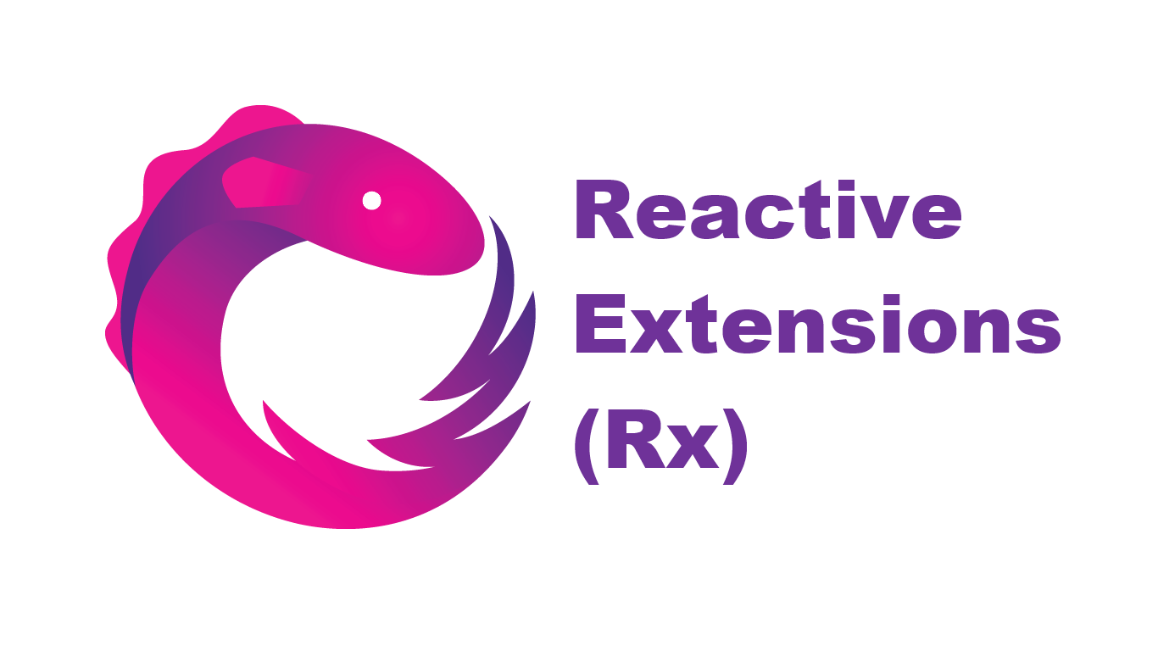

Reactive Programming with .NET

Slide 2
Agenda
Reactive Programming
Reactive Extensions (Rx)
Code, Code, Code
(F#)-Agents
Code, Code, Code

Slide 3
Reactive Programming
System is modeled as set of operations
Data flows from operation to operation
Lends itself to functional programming style
Synonyms: event-based, event-driven, message-driven

Slide 4
Reactive Extensions (Rx)
Open source library from Microsoft
Observable sequences (IObservable interface)
LINQ-like queries
Learning resources:
http://reactivex.io/
http://www.introtorx.com/
https://github.com/Reactive-Extensions/Rx.NET

Slide 5
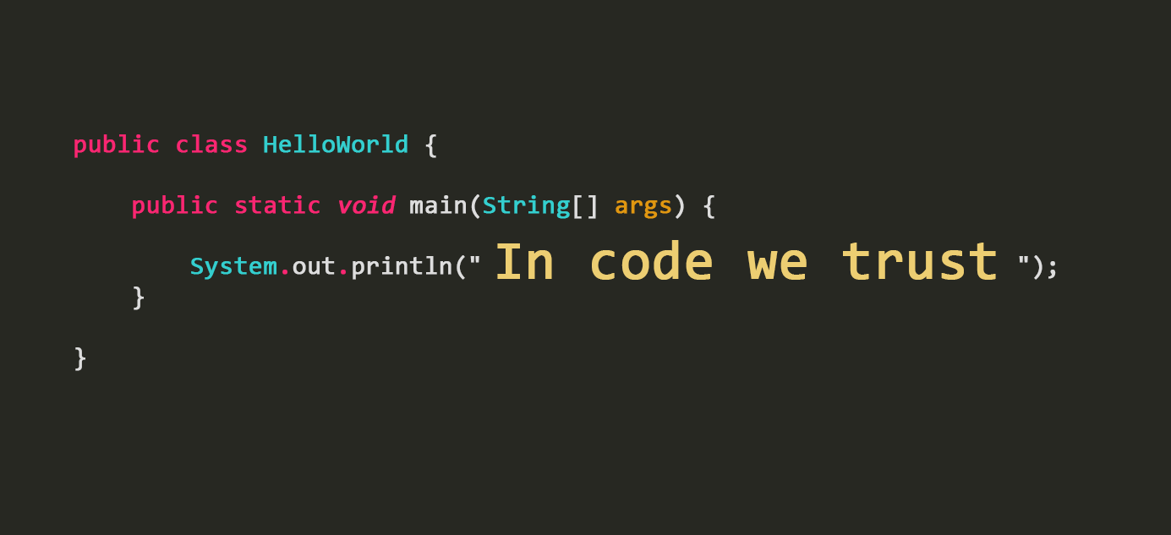
Coding Time

Slide 6
(F#)-Agents
Isolated components that fulfil a single purpose
Communicate via messages
Usually single-threaded
Implemented in F# as MailboxProcessor<‘Message>
Learning resources:
http://fsharpforfunandprofit.com/posts/concurrency-actor-model/
http://www.developerfusion.com/article/139804/an-introduction-to-f-agents/

Slide 7

Coding Time 2

Slide 8

Thank you!

